Slide 1


DF
LECTURE
Investigative Process
Diploma in CSF/IT
Year 2/3 (2025/26), Semester 4/6
Digital Forensics
2
Notes:
Left-hand Bar – Replace FSP by your module code and X by the lecture number.
Replace Lecture Title
Replace < Module Name >
Replace Year and Semester if necessary

Slide 2
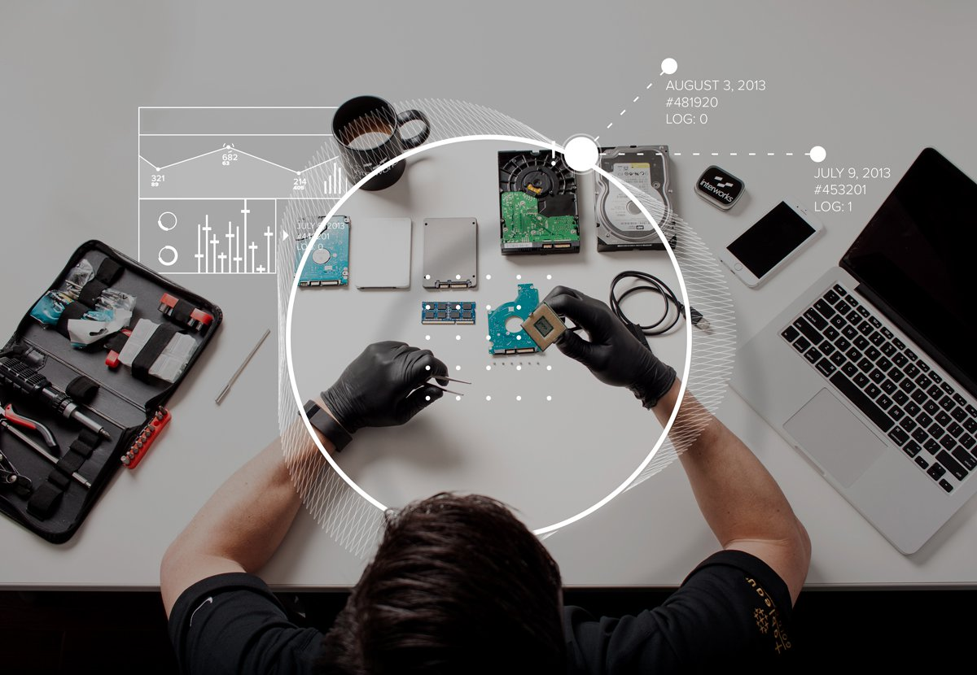
Objectives
At the end of this, you will get to know more about:
Key steps in forensics investigative process
First response procedure at the crime scene

Slide 3
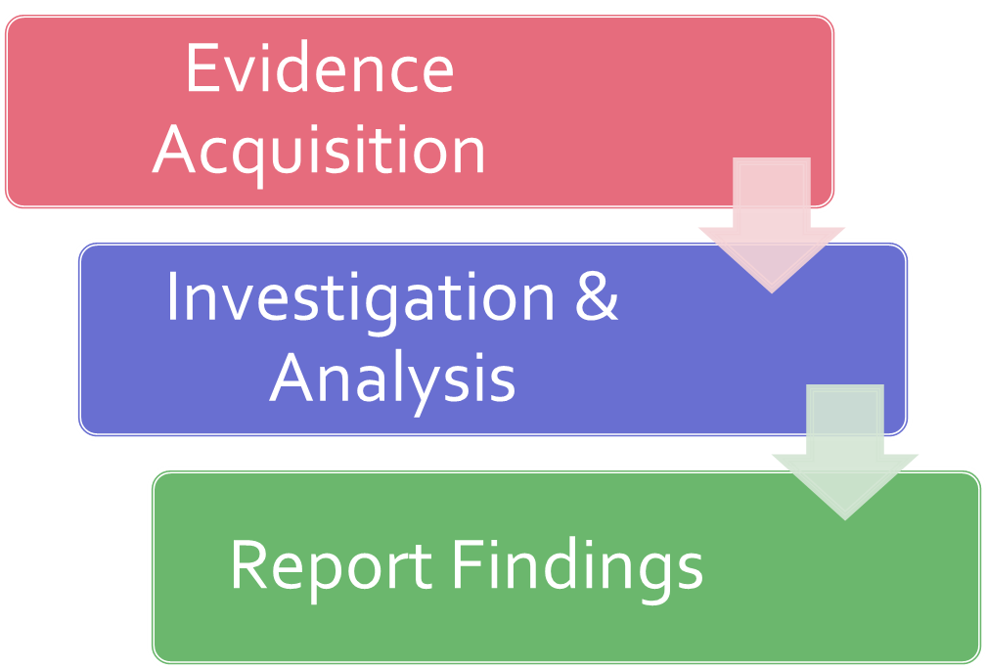
Recall: Forensics in a Nutshell

Slide 4
Investigation in Action
Data Forensic Investigation (9min19sec)
https://www.youtube.com/watch?v=pjkD1ABkBsw

Slide 5
Key steps in Forensic Investigative Process
Step 1: A crime is suspected.
Step 2: Do preliminary assessment of the case.
Step 3: Obtain a search warrant for seizure (if required).
Step 4: Perform first response procedures at crime scene
(involve 6 steps).
Step 5: Perform Forensic duplication/imaging at forensic lab.
Step 6: Generate MD5 checksum (hash) on the images.
Step 7: Prepare Chain of Custody. (may have already started at crime scene)
Step 8: Store the original evidence in a secure location.
(in Evidence Bag)

Slide 6
Key steps in Forensic Investigative Process – cont.
Step 9: Analyze the image copy for evidence.
Step 10: Prepare relevant forensic reports.
Step 11: Submit the report to the client.
Step 12: If required, attend court and testify as an expert witness.

Slide 7
Preliminary Assessment of Case
Before starting investigation, FI should determine the occurrence of the incident and its impact.
Know what to look out for at crime scene.
List the steps to be taken during investigation.
Computer forensic examiners should assess digital evidence thoroughly with respect to the scope of the case to determine the course of action to take.
Not all evidence is appropriate for admission in court.
Notes:
🧾 Preliminary Assessment
Confirm that an incident occurred and identify impact + scope
Decide what to collect and how to handle evidence
Evidence must be:
Relevant → Proves or disproves facts
Admissible → Legally obtained and acceptable in court

Slide 8
Preliminary Assessment of Case – cont.
The evidence should be relevant and admissible.
Relevant evidence is any evidence that proves or disprove the facts in a case. (useful to the case)
Admissible evidence is evidence that conforms to all regulations and statues governing the nature and manner in which it was obtained and collected. (allowed in court)

Slide 9
Preliminary Assessment of Case – cont.
Prioritise the evidence
Location of evidence at the crime scene
Stability of media to be examined
Establish how to document the evidence (e.g. photograph, sketch, notes).
Evaluate storage locations for electromagnetic interference.
Evaluate the necessity to provide unregulated power supply to battery-operated devices.
Notes:
However, Windows has limited the filenames to 240 chars.

Slide 10
Preparation Stage
What to find out before you go to crime scene?
Description of incident
Incident manager running the incident
Location of incident
Details of what to be seized
Other work to be performed at scene (e.g. full search required?)
Notes:
🧰 Preparation Stage
Before going to the crime scene:
Know: what happened, where, who’s in charge
Bring tools like:
Forensic software, external drives, write-blockers
Digital camera, notepad, gloves, anti-static bags, toolkits
Evidence bags, evidence tape, cable ties

Slide 11
Preparation Stage – cont.
What to take with you before you leave? Suggested items involved:
For acquisition:
Forensic software
Large capacity storage drive
Live response tools (e.g. Helix or F-response)
Write-blockers
Drive adapters for SATA/IDE/SCSI
Documentation:
Digital camera to capture live data on scenes and the state of the scene
Notepads, pens, pencils, markers

Slide 12

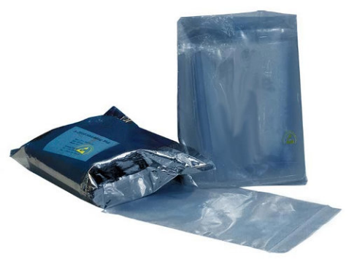
Preparation Stage – cont.
Disassembly tools:
Toolkits – screw drivers with multiple heads, wire cutters, pliers, etc.
Anti-static wrist straps
For packaging:
Anti-static bags
Evidence bags
Evidence tape
Cable ties
Sturdy boxes
Anti-static
wrist strap
Anti-static bags

Slide 13


Preparation Stage – cont.
Others:
Latex gloves
Magnifying glass
UPS

Slide 14
Search and Seizure
Before evidence is collected, the investigator has to ensure he has the right to either search or seize the evidence in question.
Voluntary Surrender
This occurs most often where primary owner is different from suspect.
For seizure of business critical-system, special arrangement is needed to avoid disruption to the business function.
Notes:
🔐 Search & Seizure
Voluntary surrender → owner willingly gives evidence
Search warrant → legal document allowing officers to seize evidence without warning
Warrants can apply to entire areas or specific devices

Slide 15
Search and Seizure – cont.
Search Warrant
A search warrant allows law enforcement officers to acquire evidence from a suspect’s machine without giving suspect/owner prior notice.
This is to avoid damaging the evidence and render it useless if suspects knows of the investigations.
Warrants can be issued for:
Entire company, floor, room, house etc.
It can also be issued for all or part of a target computer.
This option is open only to law enforcement officials.

Slide 16
At the Crime Scene

Slide 17
First Response Procedure at Crime Scene
Steps:
Securing the scene
Conducting preliminary interviews
Documenting the scene
Searching and Seizing
Bagging and tagging
Transporting electronic evidence
Notes:
🚔 At the Crime Scene — First Response Steps
Secure the scene – keep people away
Preliminary interviews – ask who was present, passwords, offsite data
Document the scene – notes, photos, sketches (monitor, cables, etc.)
Search & seize – wear gloves, don’t change device state (if on, leave on)
Bag & tag – protect from contamination, label clearly
Transport evidence – avoid heat, magnets, and keep in safe place

Slide 18

1. Securing the Scene
This ensures that all persons are removed from the area where evidence is to be collected.
This is done by security team. To establish perimeter control, make initial entry, secure the area for search team. Search team will carry out the actual search operation.

Slide 19
2. Conducting Preliminary Interviews
This can be done in parallel with Documenting Scene.
Enquire about those who were present on site at time of offence.
Conduct interviews and record their location at time of entry and reason for being there.
During interview, gather information such as:
Owners of devices found at scene.
Passwords to access system, software or data.
Any offsite storage?
Etc.

Slide 20
3. Documenting the Scene
Before anything is touched or removed, the scene is recorded through a combination of field notes, sketches, video, or photographs.
Document physical scene:
Mouse position
Location of components found near system.
Record condition of computer system, storage media, electronic devices etc.
Take photo of monitor screen, rear of computer.
Take photo of entire site – 360 degree.

Slide 21
4. Searching and Seizing
Use latex gloves when handling computer evidence.
Avoid leaving your fingerprints, hairs, fibers and body tissues on any computer evidence.
Do not change the state of electronic devices or equipment.
If it is switched off, leave it off.
If it is switched on, leave it on.
→ Take photograph of monitor screen.
→ Record programs running on screen.

Slide 22
Handling Live System
How should the first responder handle a computer system that is operating?
Note that disconnecting power supply and network connection can destroy crucial evidence.
Option 1: “Freeze” the system by pulling power plug from the wall or back of computer. Risks:
This destroys everything in memory.
It could crash a UNIX system and corrupt the evidence files.
If the machine is running high-end business database e.g. oracle, SQL, pulling power cable can cause data corruption. To preserve the data, a normal system shutdown is preferred.
Notes:
⚙️ Handling Live Systems
Option 1: Pull power plug → fast but destroys volatile data
Option 2: Proper shutdown → safe but might change logs
Option 3: Leave running & use live forensic tools (best if authorized)

Slide 23
Handling Live System – cont.
Option 2: Perform proper shutdown. Risks:
The shutdown process itself writes many entries to activity log files and changes the state of the evidence. Evidence may become inadmissible in court.
Suspect computer could run procedures that cleanse log files on shutdown, resulting in loss of crucial evidence.
Option 3: Leave the system up and running.
Run live forensic software if given authority.
Good option if you have a manageable number of workstations.

Slide 24
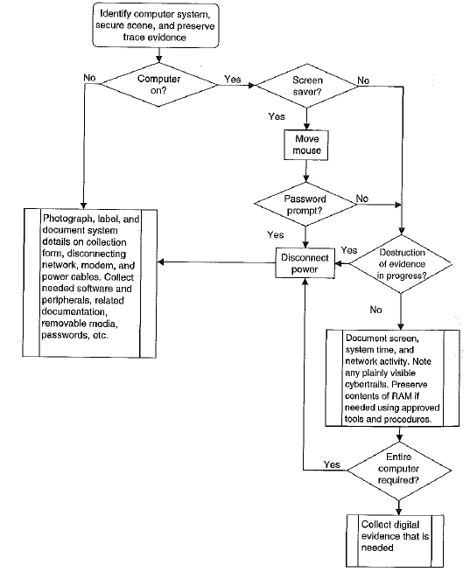
Identification and Seizure Process
Seize evidence at crime scene

Slide 25

Seizing Internal Hard Disk
If only internal hard disk is to be seized:
Wear an anti-static strap to ensure equipment is protected from static electricity.
Disassemble the case of the computer to be examined to permit physical access to the storage devices.
Ensure equipment is protected from magnetic fields.

Slide 26
Seizing Internal Hard Disk– cont.
Document internal storage devices and hardware configuration:
Drive condition (e.g. model, geometry, size)
Internal components (e.g. sound card, video card, MAC address etc.)
Disconnect storage devices (using the power connector or data cable from the back of the drive or from motherboard) to prevent the destruction, damage, or alteration of data.

Slide 27
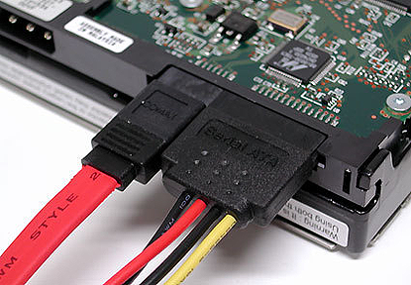
Data and Power Cables

Slide 28

Chain of Custody
All evidence presented in court of law must exist in the same condition as it was collected, in legal term, it must be in pristine condition.
The document that chronicles every move and access of evidence is called chain of custody.
The courts expects chain of custody to be complete and without gaps.
The chain starts when evidence is collected.
Notes:
💽 Chain of Custody
Tracks who handled evidence, when, where, and why
Ensures evidence remains in its original condition
Must be complete and without gaps

Slide 29
Chain of Custody – cont.
Chain of custody is used to prove the integrity of evidence. It should answer:
Who collected the evidence?
Where is the evidence stored?
Who took possession of the evidence?
How was the evidence stored and protected during storage?
Who took the evidence out of storage and why?
Who? What? Where? When? How?

Slide 30
Chain of Custody – cont.
To demonstrate a complete chain of custody, the following should be recorded in evidence log/form:
Date and time of action
Action type (examples shown below)
Initial evidence collection
Evidence location change
Remove evidence for analysis
Return evidence to storage
Personnel collecting/ accessing evidence

Slide 31
Chain of Custody – cont.
Computer descriptive information
Computer make and model
Serial number(s)
Location
BIOS settings specific to disk drives
Disk drive descriptive information
Disk drive manufacturer, model, serial number
Drive parameters(head, cylinders, sectors per track)
Handling procedure
Preparation (static grounding, prevention of physical shock, etc.)
Contamination precautions taken

Slide 32
Chain of Custody – cont.
Complete description of action
Procedure used
Tools used
Description of each analysis step and its results
Reason for action

Slide 33
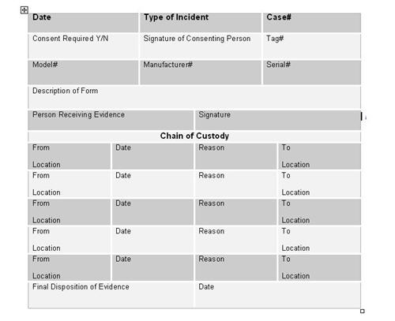
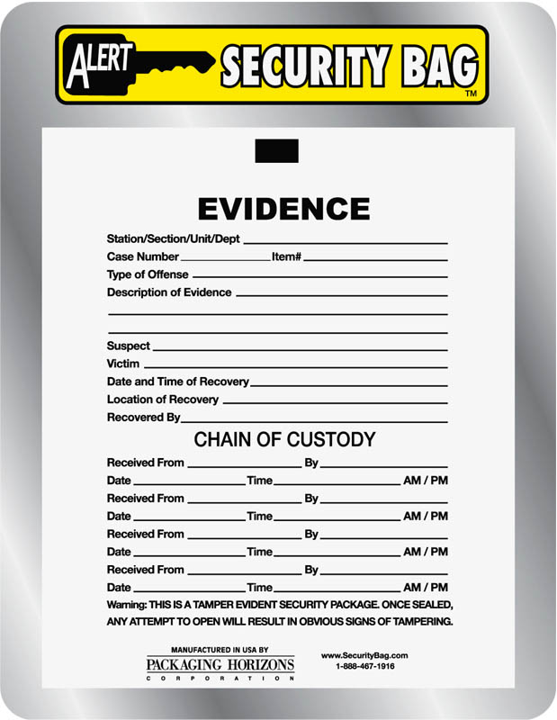
Examples of Chain of Custody Log

Slide 34
5. Bagging and Tagging
Bagging – protects against contamination and tampering.
Tagging – provides a means of associating the attached and bagged evidence with a particular location, date, time, case, event, and seizure agent. It provides a first link in the chain of custody of the evidence.
Notes:
🏷️ Bagging & Tagging
Bagging = protect against tampering
Tagging = link item to case, time, and collector
Example format: AAA/DDMMYY/0001/ZZ → initials / date / sequence number / sub-item

Slide 35
5. Bagging and Tagging – cont.
Label all the cables and photograph the rear of the computer with cables and tags in place.
Pack magnetic media in antistatic packaging.
Exhibit numbering should follow this format:
aaa/ddmmyy/nnnn/zz where
‘aaa’ is the initials of forensic analysts seizing the equipment.
‘ddmmyy’ is the date of seizure
‘nnnn’ is the sequence number of exhibits seized by ‘aaa’-starting with 001.
‘zz’ is the sequence number for the parts of the same exhibit.

Slide 36
6. Transporting Electronic Evidence
Handling transportation to forensic lab.
Keep electronic evidence collected away from magnetic sources (e.g. radio transmitter, speaker magnets etc.) as it can damage electronic evidences.
Store evidence away from high temperature and humidity. Conditions too hot, cold or humid can damage evidence.
Do not place them in car boot. Rear seat is a better choice.
Maintain chain of custody on evidence to be transported.

Slide 37
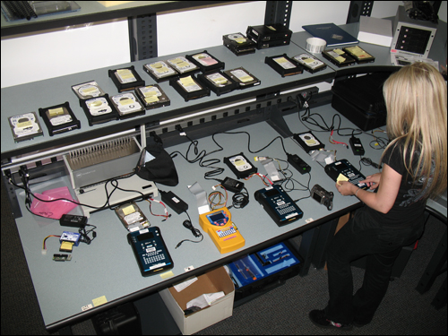
At the Forensic Lab

Slide 38
Evidence Acquisition
The original evidence should be acquired in a manner that protects and preserves the integrity of the evidence.
Steps:
Document hardware and software configuration of the examiner’s system.
Disassemble the case of the computer to be examined to permit physical access to the storage devices.
Take care to ensure equipment is protected from static electricity and magnetic fields.
Notes:
🧪 At the Forensic Lab
Acquire original evidence safely
Document hardware/software setup
Ensure examiner’s system is forensically clean (no prior data)

Slide 39
Evidence Acquisition – cont.
Identify storage devices that need to be acquired. These devices can be internal, external, or both.
Document internal storage devices and hardware configuration.
Drive condition
Internal components
Disconnect storage devices (using the power connector or data cable from the back of the drive or from the motherboard) to prevent the destruction, damage, or alteration of data.

Slide 40
Evidence Acquisition – cont.
Whenever possible, remove the subject storage device and perform the acquisition using the examiner’s system.
Ensure that the examiner’s storage device is forensically clean when acquiring the evidence.

Slide 41
Documenting and Reporting
Actions and observations should be documented throughout the forensic processing of evidence.
This will conclude with the preparation of a written report of the findings.
Documenting the steps following in analysis of the digital evidence examination.
Everything relevant to the case should be documented and it should be a continuous process.
Notes:
📝 Documentation & Reporting
Write everything down – dates, actions, results
Record irregularities and network/user info
Final step: Forensic report summarizing findings

Slide 42
Documenting and Reporting – cont.
Factors to consider during the documentation process:
Include dates, times, and descriptions and results of actions taken.
Document irregularities encountered and any actions taken regarding the irregularities during the examination.
Include additional information such as network topology, list of authorized users, passwords.

Slide 43
Inside a computer forensics lab
Computer Forensics (by Disklabs Computer Forensics Services) (10min40sec)
http://www.youtube.com/watch?v=GVbV_onexrM

Slide 44
Maintaining Professional Conducts
Consider all the available facts that account to the crime scene.
Ignore external biases to maintain the integrity of the fact-finding in all investigations.
Keep the case confidential.
Stay current with the latest technical changes in computer hardware and software, networking, and forensic tools.
Notes:
👮‍♂️ Professional Conduct
Be unbiased
Stay confidential
Keep skills and tools updated

Slide 45
Summary
Take a systematic approach to investigations.
Take into consideration the nature of the case, instruction, and tools.
Activities relating to the seizure, examination, storage, or transfer of digital evidence should be documented, preserved, and available for review.
It is important to maintain professional conducts throughout the investigation.

